Slide 1
RATINGS PREDICTION
TINU SHIBY

Slide 2
INTRODUCTION
All the E-Commerce websites rely greatly on customer satisfaction, and customer’s used to express their opinions by writing reviews on whatever product they purchased. Now the company wants to predict the ratings from the review.Company offers a rating out of 5 stars.The motive behind such an initiative is that the decision to purchase a product depends on the reviews and ratings.
Motivation for the project is that many product reviews are just textual, making it difficult to identify so its better to have a star rating. Getting an overall sense of textual review could in turn improve consumer experience.

Slide 3
Data collection
The details of cars are collected from the website of flipkart scrapped the details of almost 20077 products.
The following items are scrapped:
Reviews
Ratings
Dataframe was created and converted to csv file for model building.

Slide 4
Data analysis
The goal is to find out how price varies according to the variables. To start with the data analysis, i have imported the following:
Pandas
Matplotlib
Seaborn
Train test split
Logistic Regression
Decision Tree Classifier
Random Forest Classifier
SVC
XGBoost Classifier
GridSearchCV
Cross-validation score
Classification report
Plotted a graph which represents the count of each ratings

Slide 5
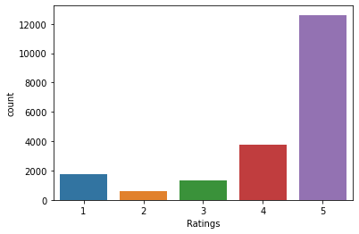

Slide 6
Data preprocessing
Data preprocessing is a data mining technique which is used to transform the raw data in a useful and efficient format.
Dataset doesn’t have any null values.So started the data cleaning. Below are the steps taken to clean the data:
Converting to lower case
Removal of Special characters
Removal of numbers
Removal of hyperlinks
Removal of whitespaces
Then with the help of WordNet plotted the graph for each rating.
Converted the text to vector by TF-IDF method.
Applied SMOTE technique to make the data balanced.
Applied GridSearchCV to find out the best parameters of Random Forest Classifier.
Through pickle saved the model.

Slide 7
Building machine learning model
As the problem is a classification problem I have used the following models:
Logistic Regression
Decision tree Classifier
Random forest Classifier
SVC
XGBoost Classifier
Model | Accuracy | Cross-Validation score | Difference
Logistic Regression | 78.21 | 70.75 | 7.46
Decision tree | 86.23 | 78.46 | 7.77
Random Forest | 89.58 | 82.94 | 6.64
SVC | 87.94 | 81.00 | 7.94
XGBoost | 81.82 | 74.98 | 6.84

Slide 8
Best Model
Random Forest Classifier is selected as the best model on the basis of accuracy as well as it has the least difference.

Slide 9
conclusion
To predict the ratings, used Natural Language Processing toolkit as well as Machine Learning Algorithms and selected Random Forest Classifier as the best model
Few challenges faced while doing the project is the class imbalance and presence of a lot of text data. With SMOTE technique and TF-IDF method solved that two challenges
As with any project there is room for improvement here. We couldn’t reach to the goal of maximum accuracy in the project, we did end up creating a system that can with some improvement and deep learning algorithms get very close to that goal.

